Slide 1
Holochain
Group-5

Slide 2
Group Members
Name
Roll
Raisul Islam
Rakibul Hasan Somrat
Md. Rashedul Islam
Samiun Islam
Minhaz Hossain Asif
Md. Ziaur Rahman Joy
Sayd Mahfid Rahman
1995
1997
2004
2007
2011
2012
2014

Slide 3
Introduction to Holochain
Holochain is a decentralized application platform that aims to provide a more efficient, scalable, and secure alternative to traditional blockchain technology.
Holochain uses a distributed hash table (DHT) to maintain separate ledgers for each user unlike traditional blockchains, which use a single, shared ledger to store data.
It allows each user to have their own data, rules, and history, while still being able to communicate and interact with others on the network.
Holochain is designed to support the development of decentralized applications (dApps) that can be used in a wide range of industries, such as finance, social media, supply chain management, and more.
It allows developers to build custom applications that are tailored to their specific needs, while still being able to participate in the broader Holochain network.

Slide 4
Introduction to Holochain
.
Holochain is powered by the Holo fuel cryptocurrency, which is used to pay for hosting and services within the Holochain network.
The project is governed by the Holochain Association, which is responsible for overseeing the development of the technology and setting its strategic direction.
The Holochain community is also actively involved in shaping the direction of the project, and there are numerous resources available for developers and users to get started with Holochain.

Slide 5
Holochain Architecture
Holochain architecture is interesting — it can be summed up as “shared DHT” where DHT stands for the distributed hash table. It overcomes the blockchain bottlenecks by keeping the key features of block chain intact. We can term it as “blockchain without bottlenecks.”
It achieves it with the help of Shared Data Integrity. It is a way of handling data in peer-to-peer systems where it is much more challenging to secure data compared to centralized data.
With shared data integrity, it offers robust data security without bringing limitations such as high computation demand.
The key component here is the distributed hash table (DHT), which provides great value to the ecosystem. It offers eventual consistency while ensuring that the data is propagated safely through the network. This way, each peer is accountable for his actions.

Slide 6
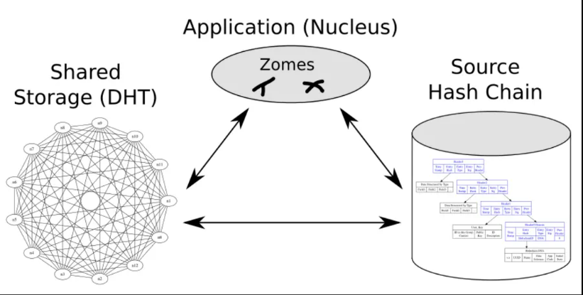
Holochain Architecture
The architecture is also efficient as it ensures that the overhead is as feasible as possible. In fact, phones or other devices can join the network and improve computing power.
The Holochain Architecture (dApp architecture) consists of three main sub-systems. They are:
Shared storage (DHT)
Application (Nucleus)
Source Hash Chain

Slide 7
Machanism
Holochain's consensus mechanism is based on a unique approach called "distributed hash table (DHT) validation" unlike traditional blockchain networks that use proof-of-work (PoW) or proof-of-stake (PoS) for consensus.
Holochain uses a combination of validation rules, cryptographic signatures, and distributed hash tables to validate transactions.
In Holochain, each node in the network acts as its own validation authority and is responsible for maintaining a local chain of validated transactions.
When a new transaction is submitted, it is validated by the nodes in the network that have a copy of the relevant data. If a majority of nodes agree that the transaction is valid, it is added to their local chains and the updated chain is then shared with the rest of the network.
The decentralized validation process ensures that the network is able to reach consensus without relying on a central authority or a small group of validators.

Slide 8
Machanism
It also helps to improve the scalability and efficiency of the network by reducing the need for large amounts of computational power to validate transactions.
The advantages of Holochain's consensus mechanism include:
Increased security: By using cryptographic signatures, Holochain ensures the integrity of transactions and the network as a whole.
Improved scalability: The decentralized validation process allows the network to validate transactions faster and more efficiently, even as the number of transactions grows.
Enhanced privacy: Holochain allows users to retain control over their data and privacy by eliminating the need for a central authority to validate transactions. This is a general explanation of Holochain's consensus mechanism.

Slide 9
Transaction
The transaction processing in Holochain is a decentralized process that involves multiple nodes in the network. Here's how it works:
A transaction is created by an agent and signed with the agent's private key. The transaction is broadcast to the network and received by multiple nodes.
Each node in the network runs its own set of validation rules on the transaction to determine if it is valid or not. If a majority of nodes agree that the transaction is valid, it is added to each node's local chain and broadcast to the rest of the network.

Slide 10
Transaction
Once a transaction has been added to a node's local chain, it becomes part of the permanent record of the network and cannot be altered or deleted.
The network uses the cryptographic hashes of each transaction to ensure the integrity and consistency of the data stored on the network.
This decentralized transaction processing allows Holochain to be more scalable and efficient than traditional blockchains, as there is no need for a centralized consensus mechanism or a global ledger.
It also allows the network to be more resistant to certain types of attacks, as there is no single point of failure in the system.

Slide 11
Holochain Use Cases
Holochain is a versatile framework. It also means that it can be used for a plethora of real-world use-cases.
Social Networks: Social network is the best use-case of Holochain. It is useful considering that a social network can work without being connected, and the user can keep a copy of it locally.
Supply Chains: Supply chains can also benefit immensely from Holochain. It can provide a unique way to handle the supply chain irrespective of organization, company, or geo-location.

Slide 12
Holochain Use Cases
P2P Platforms: P2P platforms can take proper use of Holochain. Small communities can set it up according to their requirements. The P2P platform can also communicate with other networks and make proper use of Holochain capabilities.
Collaborative Applications: Holochain is a great choice to build collaborative apps such as chats, scheduling, discussion, or even Wikis.
Rating platforms: Rating platforms can be created, managed, and set up using Holochain.

Slide 13
When NOT to Use Holochain?
Private or Secret Data: If you are thinking of protecting your secure or private data, then you should avoid Holochain. It takes a lot of effort, private or secure, or even anonymous. If you know what you are doing, then you can go forward and use it. Otherwise, we recommend not to use it.
Self-Exploration: If you are thinking of creating an Holochain application only for yourself, then it is not a good idea. It is not ideal for one-person use. However, if you want to use it to synchronize data across multiple devices, then it can be used.

Slide 14
When NOT to Use Holochain?
Huge Files: The last use-case where you should not use it is to store large files. That’s because each peer can have its copy of the ledger. If it is significant, then it defeats the purpose of the Holochain and makes the whole process painfully slow.

Slide 15
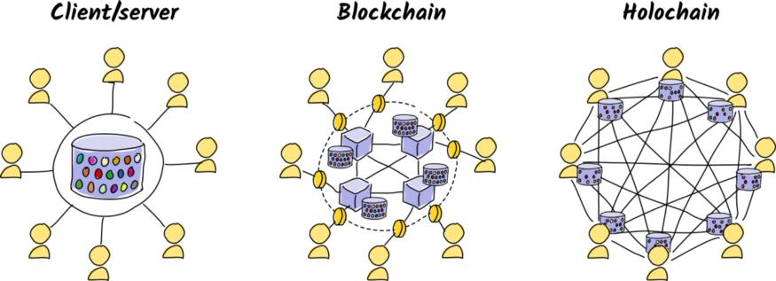
Difference between block chain and holochain and client/server
Client and Holochain are both terms used in the context of decentralized technology, but they refer to different aspects of the technology.
A client, in the context of decentralized technology, refers to a software program that connects to a decentralized network, such as a blockchain or a Holochain network.
A client allows users to interact with the network, send transactions, and access data stored on the network.

Slide 16
Difference between block chain and holochain and client/server
Holochain, on the other hand, is a specific type of decentralized technology that is used to build decentralized applications.
Holochain is a data-centric, peer-to-peer framework that allows for the creation of decentralized applications that are more scalable, efficient, and secure than traditional blockchain-based applications.
In a blockchain architecture, all data and transactions are stored on a decentralized, global ledger that is maintained by multiple nodes in the network. Each node has a copy of the ledger and transactions are validated and added to the ledger through a consensus mechanism, such as proof-of-work.

Slide 17
Difference between block chain and holochain and client/server
The difference between a client-server architecture and a blockchain or Holochain architecture lies in the way data and transactions are handled and stored in each system.
In conclusion, the main difference between client-server, blockchain, and Holochain architectures is the way data and transactions are stored and processed in each system.
While client-server architecture is centralized and vulnerable to single points of failure, blockchain and Holochain architectures are decentralized and provide more security and scalability.

Slide 18
Merit
Decentralization: Holochain is a fully decentralized platform, meaning there is no central point of control or single point of failure, providing greater security and resilience to the network.
Scalability: Holochain is designed to be scalable, allowing it to handle a large number of users and transactions. This makes it well-suited for high-traffic applications and use cases.
Efficiency: Holochain's unique approach to data management, where each participant has their own chain, allows for increased efficiency in processing transactions, as data does not have to be shared or synchronized across the entire network.

Slide 19
Merit
Privacy: Holochain provides enhanced privacy, as each participant has full control over their own data, and the network does not rely on a central database. This makes it well-suited for use cases such as identity management and personal data storage.
Flexibility: Holochain provides a flexible framework for building decentralized applications, allowing developers to customize and configure the network to meet the specific needs of their application or use case.

Slide 20
Demerit
Adoption: Holochain is a relatively new technology, and its adoption has not yet reached the level of other decentralized technologies like blockchain. This may limit the available resources and community support for developers and users.
Performance: Holochain is designed for scalability, but it may still experience performance limitations when handling large amounts of data and transactions, especially compared to centralized systems.

Slide 21
Demerit
Interoperability: Although Holochain supports multiple programming languages and provides an API for integrating with other systems, it may still face challenges in interoperability with other platforms and technologies, particularly in the early stages of its development and adoption.
Security: Holochain's decentralized architecture provides enhanced security compared to centralized systems, but like any decentralized platform, it is still vulnerable to security threats such as hacking and malicious actors.

Slide 22
Conclusion
This leads us to the end of our Holochain Guide.
Here, we discovered about Holochain, what makes it different from blockchain, and its key features.
We also went deep into the Holochain architecture to understand how it works and what makes Holochain apps so great!

Slide 23
THANK YOU

